Slide 1
Microcontroller
Microcontroller theory with code snippets

Slide 2
Content
Microcontroller 8051
Embedded C codes for 8051
Microcontroller PIC
Embedded C codes for PIC
Microcontroller ARM
Embedded C codes for ARM

Slide 3
Microcontroller 8051
Features of 8051
8 bit CPU
4kb on chip RAM
128 byte on chip data RAM
8bit I/O ports
Two 16 bit timer
Full duplex serial port
On chip clock oscillators
Special Function Registers(21)
Accumulator(A)
Process Status Word(PSW)
I/O Port registers
Data pointers(DPH, DPL)
Stack pointers(SP)
Program counter(PC)

Slide 4
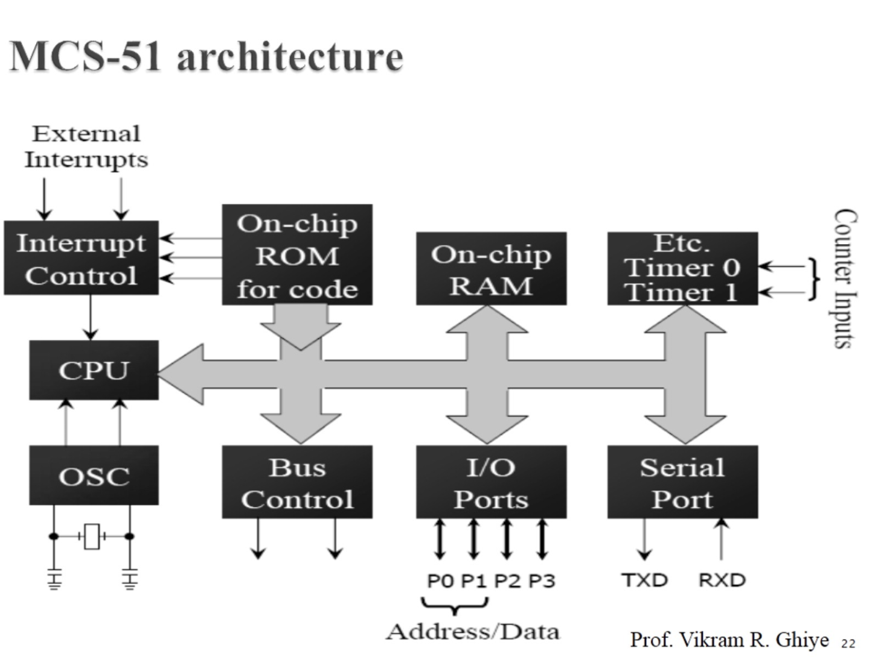
8051 Architecture

Slide 5
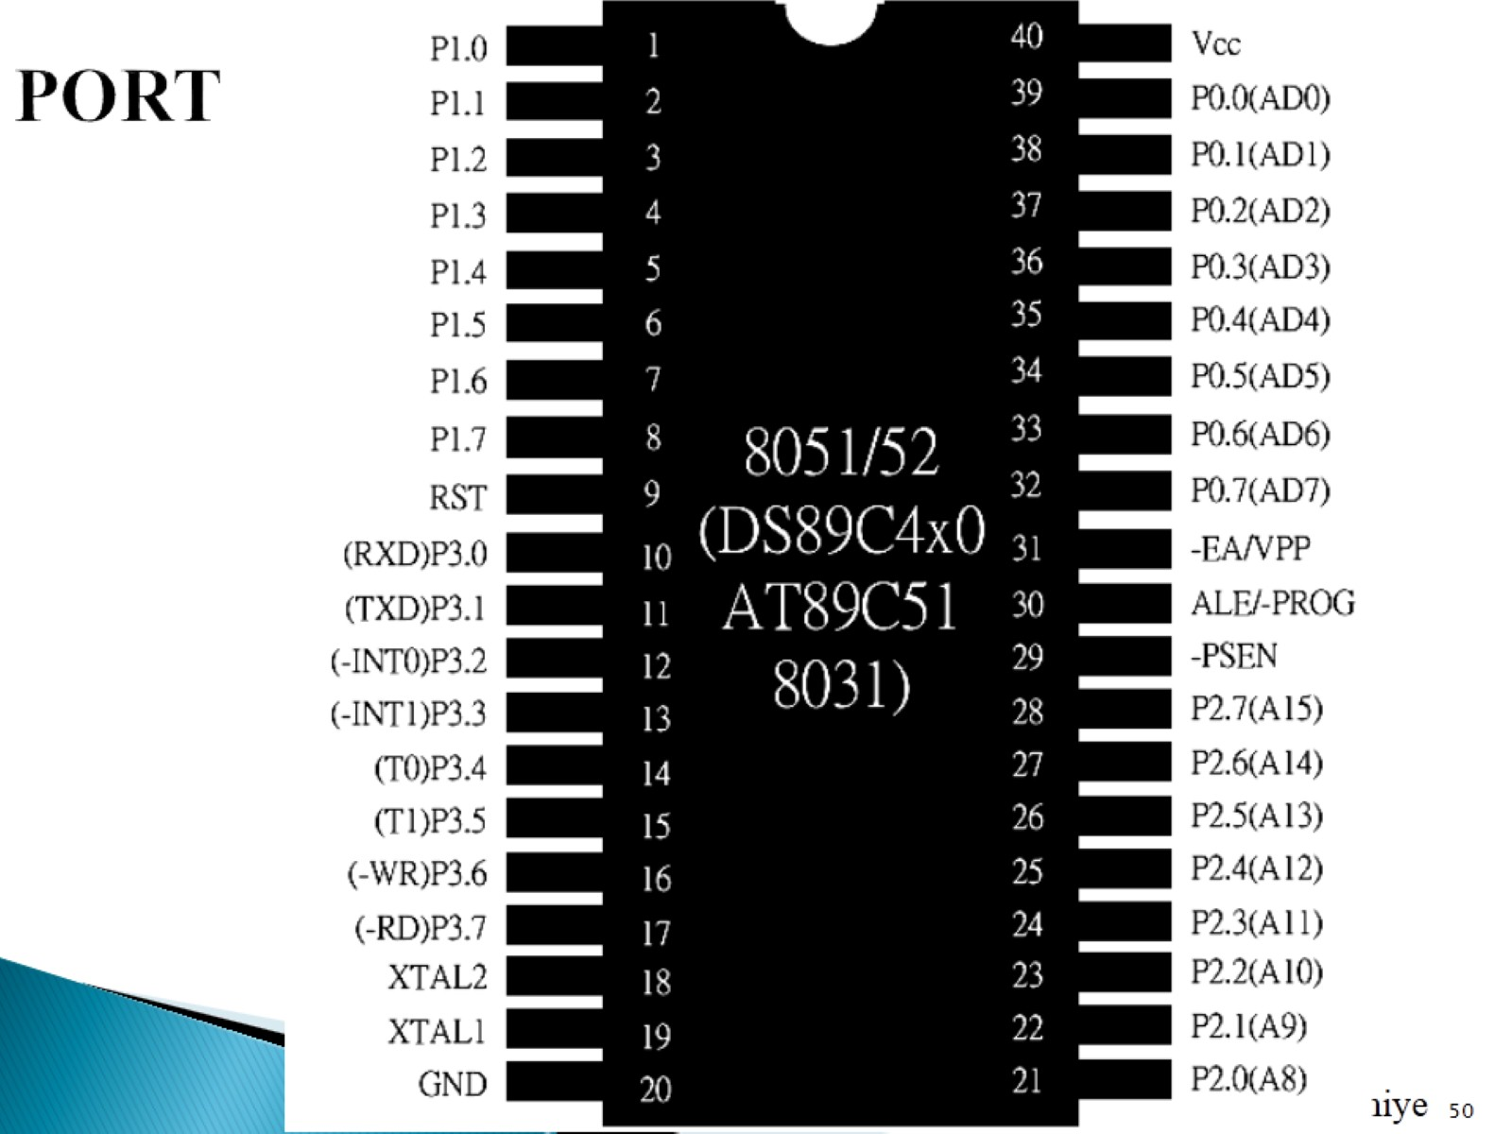

Slide 6
Peripherals
The 8051 has two 16 bit timers
That are used for timing and counting applications.
It has Interrupt structure
- Total 6 interrupts(Reset as special intrupt)
It has duplex serial port(UART)

Slide 7
Timers
8051 has two 16 bit timers -Timer 0 and Timer 1
This timer can program independently
Timer 0 has two registers[TH0( 8 bit registers), TL0 (8 bit registers)] similarly with timer 1.
Timer mode registers has 0(13 bit opertion),1(16 bit),2(8 bit auto reload),3(split timer mode) mode.
Timer control registers.

Slide 8
Interrupts
Interrupt is a signal generated by events that cause the controller to stop temporarily its current operation execution activities and perform task to service that events.
8051 has 5 interrupts (highest priority)External Interrupt 0, Timer 0 Interrupt, External Interrupt 1,Timer 1 Interrupt, Serial Interrupt(lowest priority)
Reset as a special interrupt

Slide 9
Serial communication
The IC’s commonly known as UART and USART
8051 has inbuilt USART.
Start bit is low, stop bit is high.
The rate of data transfer in serial data comm. Is stated in bps.
Baud rate and bps is not necessarily equal.
Asynchronous serial data communication the baud rate generally limited to 100000bps.
LRS232 is widely used interfacing standard.
Voltage level converter is get used such as MAX232. It is refered as a line driver. Which is basically a chip required to convert RS232 vtg levels to TTL(Time to live) and vice versa.

Slide 10
To allow data transfer the PC and 8051 system it is must to match the baud rates . In 800515 Baud rates Can be set through Timer 1
8051 has external clk freq 11.059MHz which gets divided by 12 to get machine cycle freq. = 921.6KHz.
8051 controller divides machine cycle fre by 32 i.e. 92136KHz/32= 28800Hz baud rate by timer 1

Slide 11
Program
Delay/Square Wave
ORG 0000H
LJMP MAIN
ORG 000B
CPL P2.0
ORG 0030H
MAIN: TMOD,#02H
CLR P2.0
MOV TH0,#1AH
MOV IE,#82H
SETB TR0
ABC : MOVA, #0FFH
SJMP ABC4END

Slide 12
Program Timer 0 and Timer 1
WALP to generate square wave of 1kz
ORG 0000H
LJMP MAIN
REPEAT:MOV TL1,#33H
MOV TH1,#0FEH
SETB TR1
WAIT: JNB TF1, WAIT
CLR TF1
CLR TR1
CPL P2.0
SJMP REPEAT
END

Slide 13
PIC Microcontroller
PIC Is Programmable Intelligent Computer
Features :
It has RISC architecture
On chip system programming
ROM(32k)
RAM(2048)
Data EEPROM(256)
Timers(4),Interrupts(20), Comparator(2),CCP(2)
ADC(13chAannel 1 bit)
USART
I/O Ports(A,B,C,D,E)
Internal Oscillator freq(48MHz)
Instruction set (75 instructions)
Instruction size(16 bit)

Slide 14
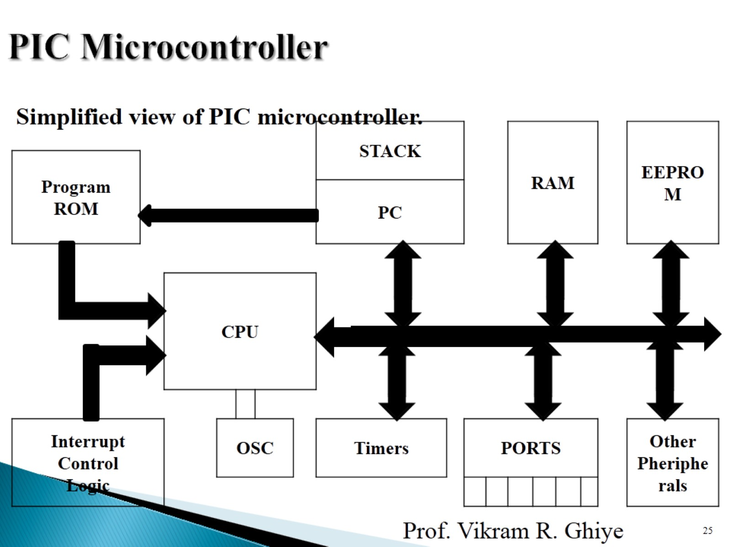
PIC

Slide 15
Registers in PIC18FXX
WREG
File Registers
SFRS
GPR
Status Register
Program Counter(points address of next instruction to be execute)
Stack Pointer(is read/write memory)
I/O Port Registers

Slide 16
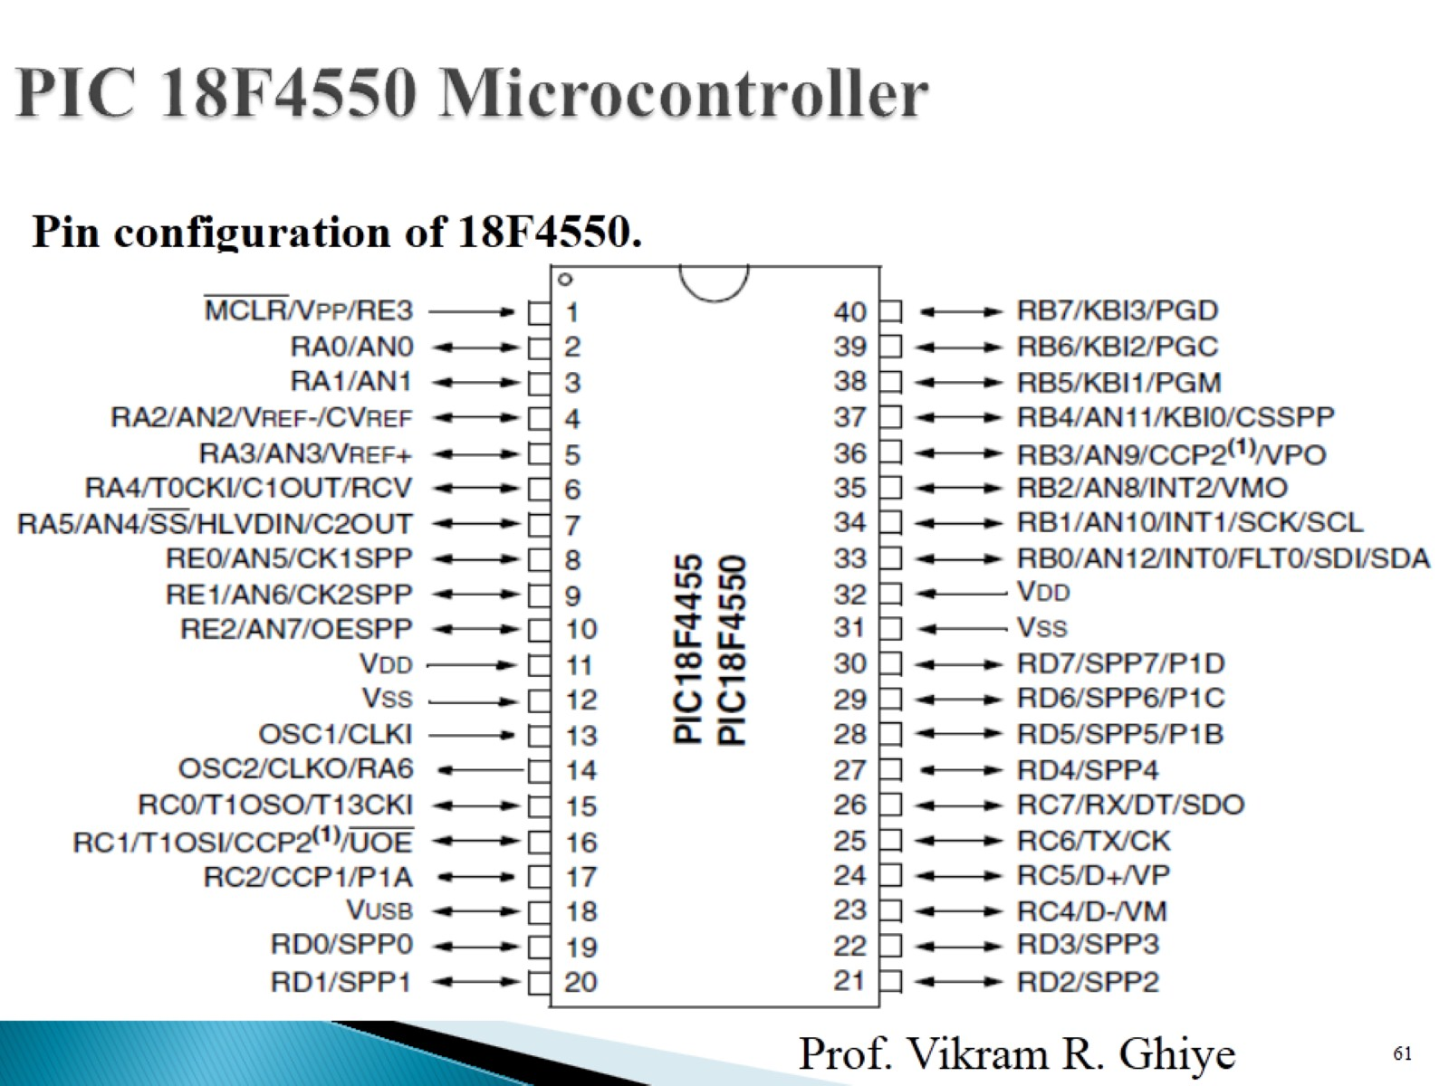
Pin out diagram

Slide 17
Oscillators
PIC 18F 4550 has three oscillators
Primary Oscillator
Secondary oscillator
Internal Oscillator

Slide 18
Timer
PIC 18FXX has five Timers each of 16 bit
Timer0, Timer1, Timer2, Timer3, Timer4

Slide 19
PIC data format
Pic supports 8 bit data.
Binary, Hex Decimal, Decimal, ASCII
PIC assembler directives(pseudo instructions)
EQU,ORG,END,SET

Slide 20
Programm
Write a code when key 1 is pressed glows LED top to bottom and key 2 is pressed LED glows bottom to top.
#include<p18f4550.h>
#define a PORTBbits.RB0
#define b PORTBbits. RB1
Void main()
{
TRIS = 0X03;
While(a=1)
{
PORTB = 0X04;
PORTB = 0X08;
PORTB = 0X10;
PORTB = 0X20;
PORTB = 0X40;
PORTB = 0X80;
}

Slide 21
While(b = 1)
{
PORTB = 0X80;
PORTB = 0X40;
PORTB = 0X20;
PORTB = 0X10;
PORTB = 0X08;
PORTB = 0X04;
}

Slide 22
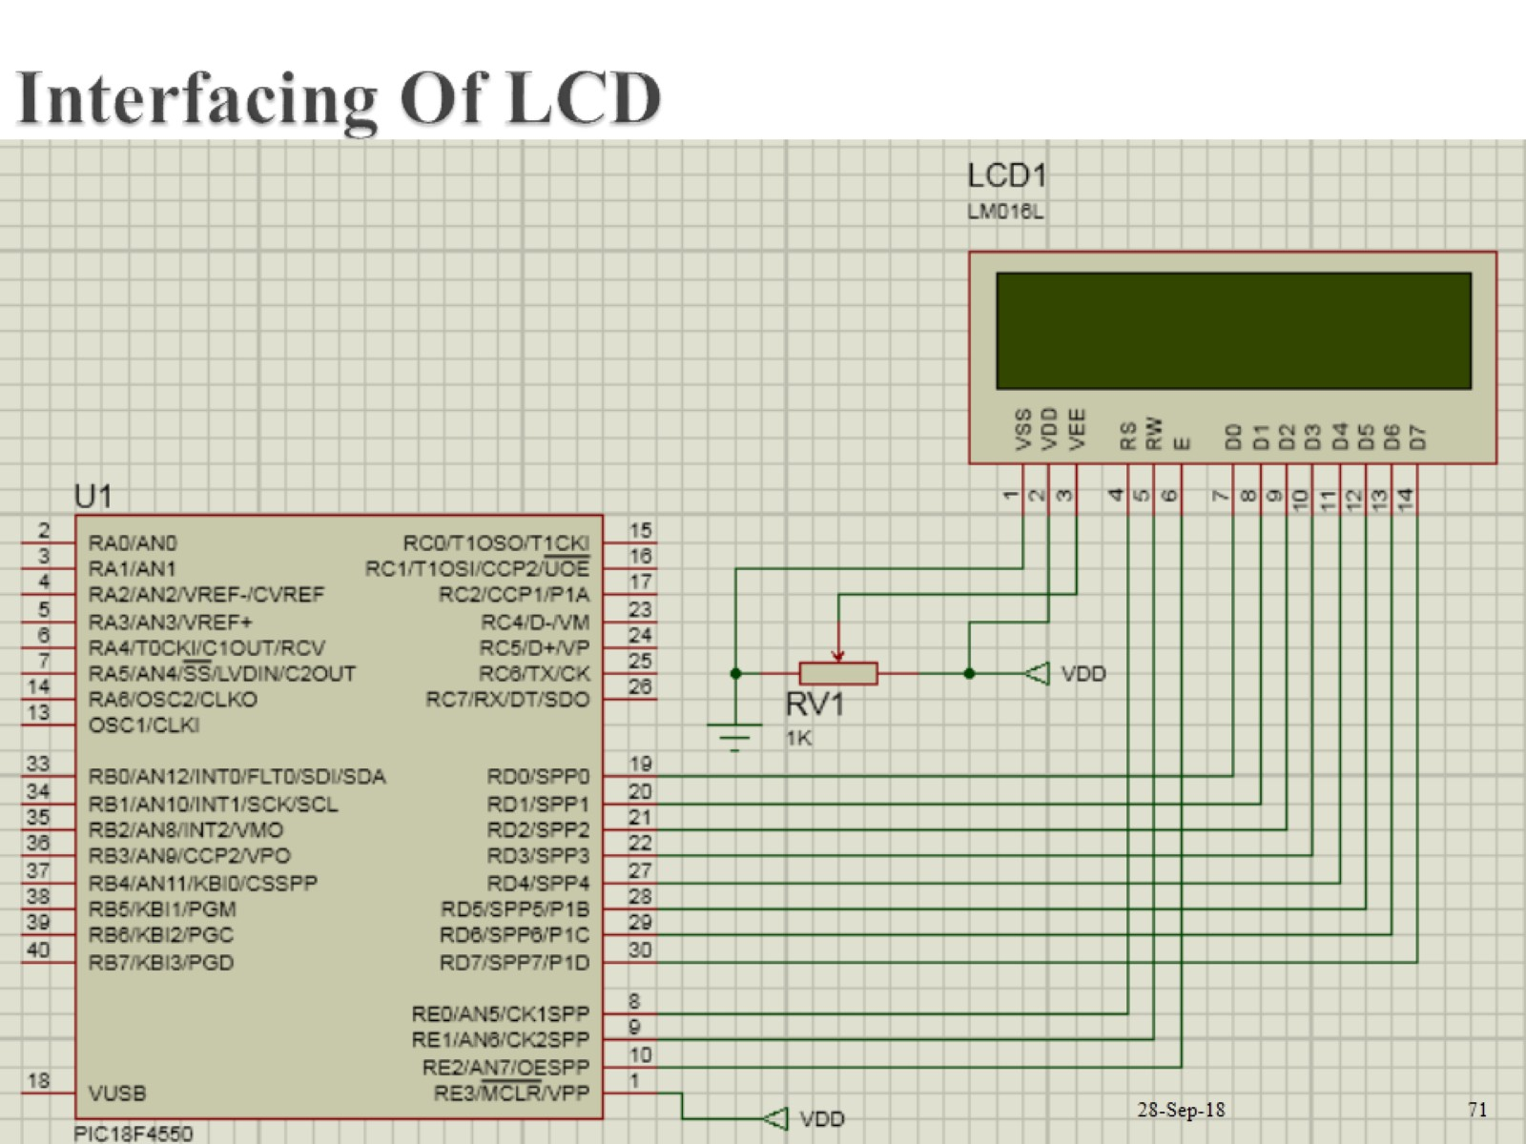
Interfacing LCD

Slide 23
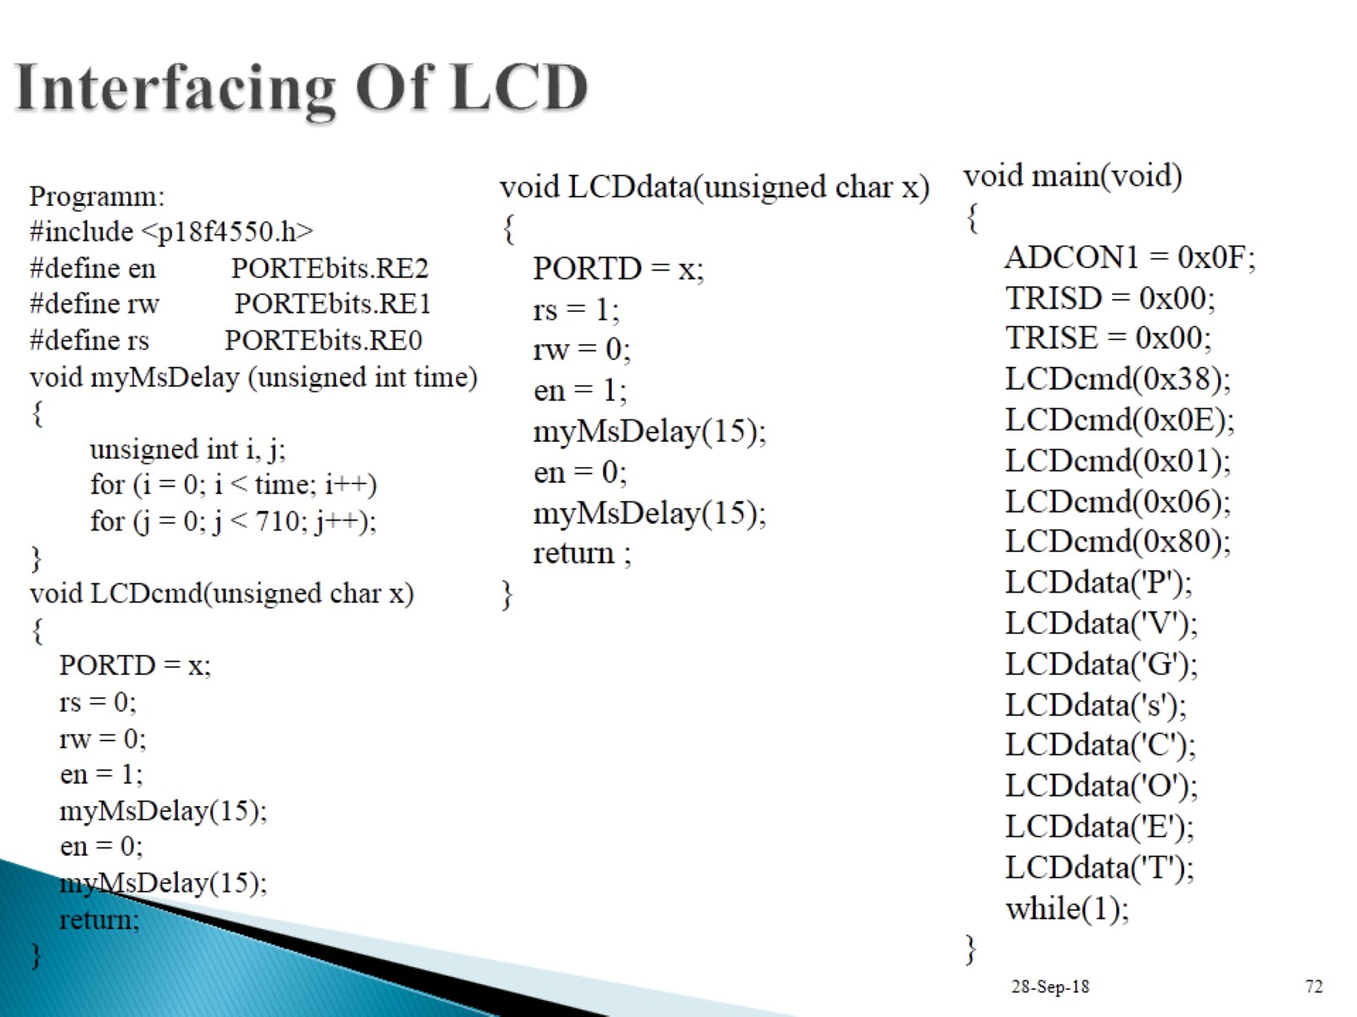

Slide 24
Pulse Width Modulation
In PWM as name suggest width of pulse get varied over a time interval.
Pulse width varies means ON TIME and OFF TIME of pulse get changes after a time of interval.
Change in on time and off time is known as duty cycle.
The pulse having period of 10 sec and stay high for 2 sec then its duty cycle is 20 %.

Slide 25
Program
WAP for generation of PWM of time 10kHz and 50 % duty cycle.PR2 = 125,CCPRIL = 62, CCP1CON = 2,T2CON = 07,DC1B2=1, DC1B1 = 0.
#include<p18f4550.h>
Void main()
{
TRISC = 0;
PR2 = 125;
CCPRIL = 62;
CCP1CON = 0X2C;
T2CON = 0X07;
while()
{
PIR1bits.TMR2IF = 0;
While(PIR1bits.TMR2F == 0);
}
}

Slide 26
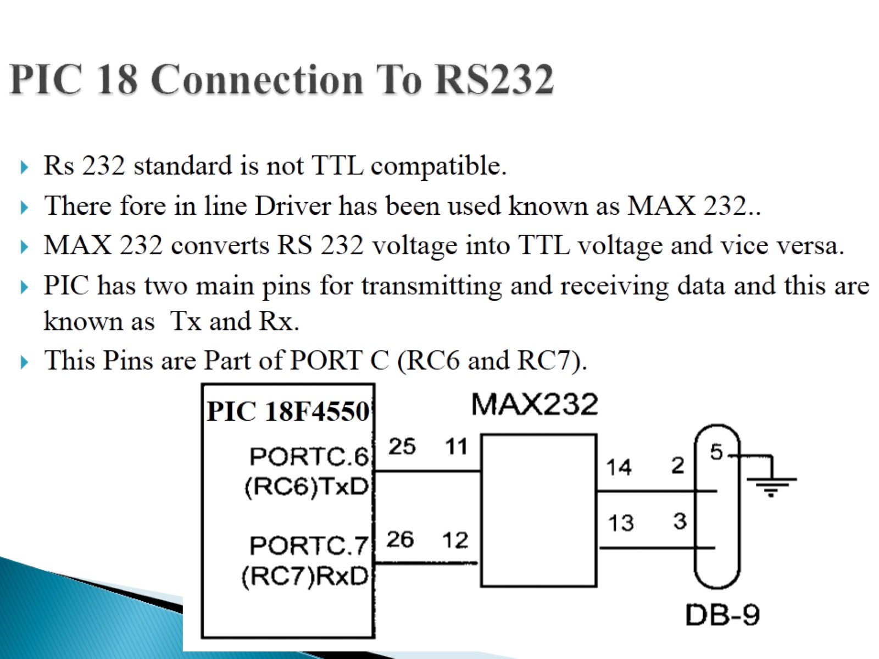
Serial communication

Slide 27
UART
There are 6 major registers which deals associates with UART
SPBRG(serial port baud rate generator)
TXREG
RCREG
TXSTA
RCSTA
BAUDCON
PIR1

Slide 28
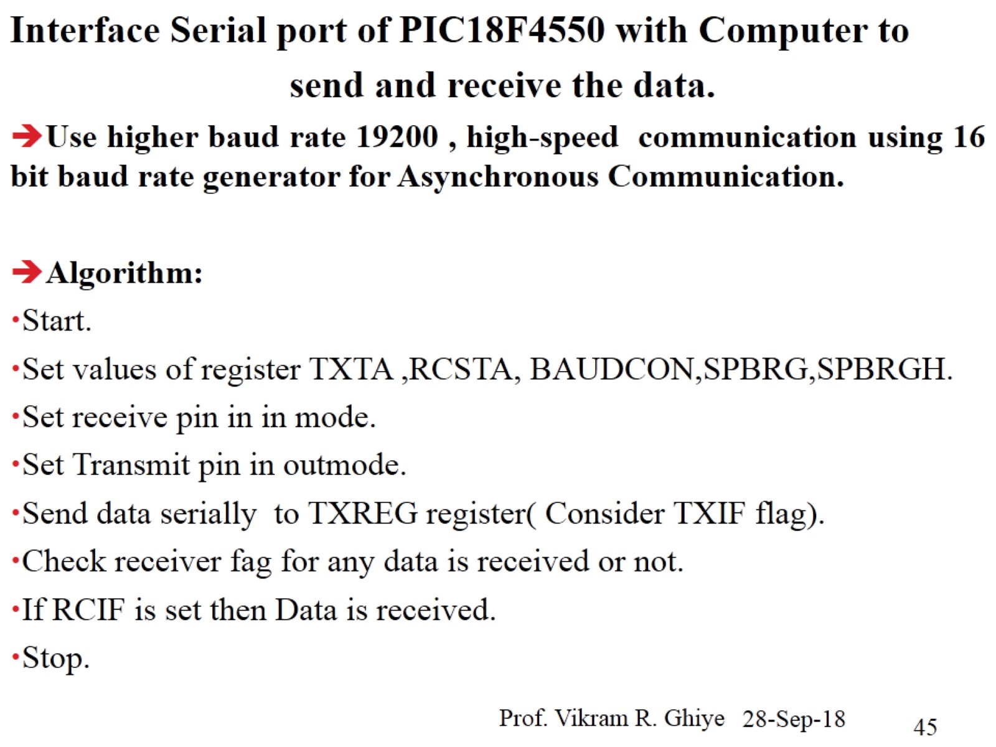

Slide 29
Use higher baud rate 19200, high speed communication using 16 bit baud rate generator for asynchronous communication
TXSTA = 0X24; // 8 bit transmission, TX enable
RCSTA = 0X90;// 8 bit reception, continuous RX
BAUDCON = 0X08;// BRG16 = 1.
SPBRG = 0X70; /113
SPBRGH = 0X02;//

Slide 30
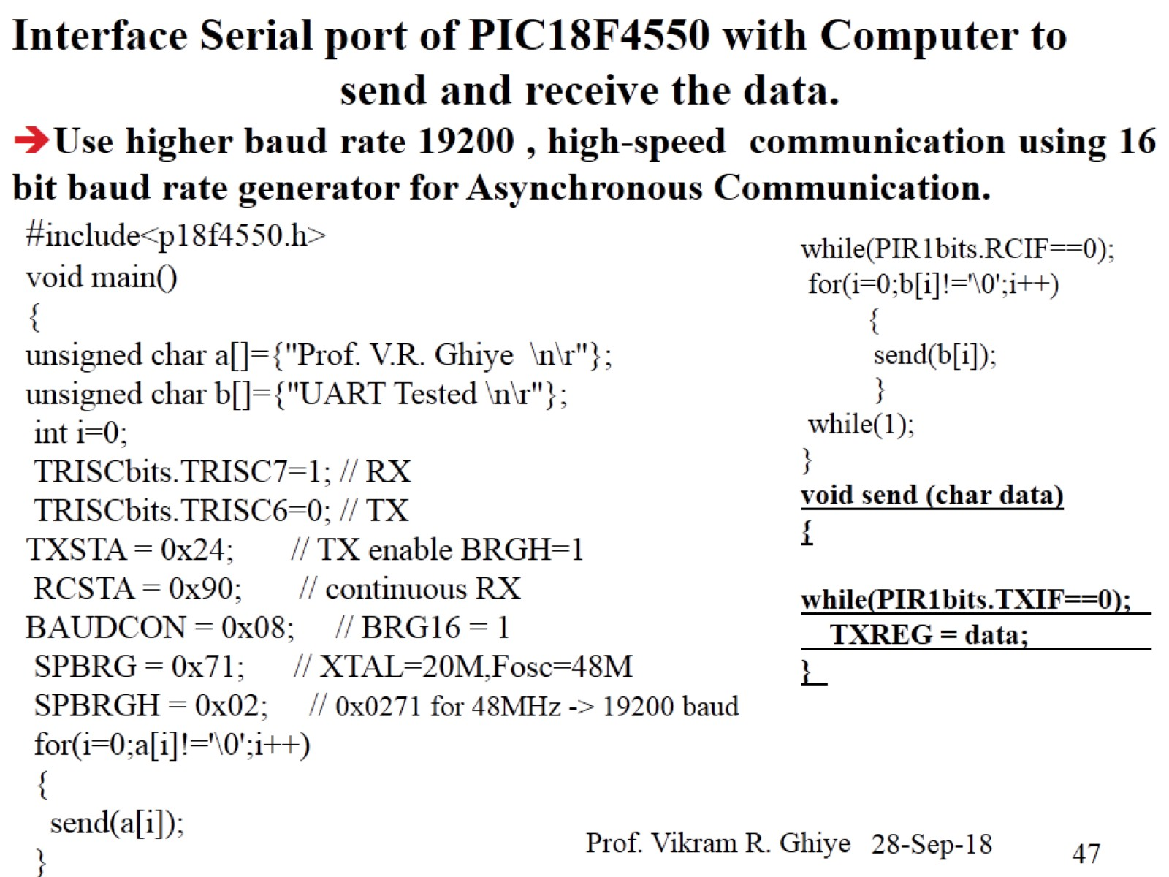

Slide 31
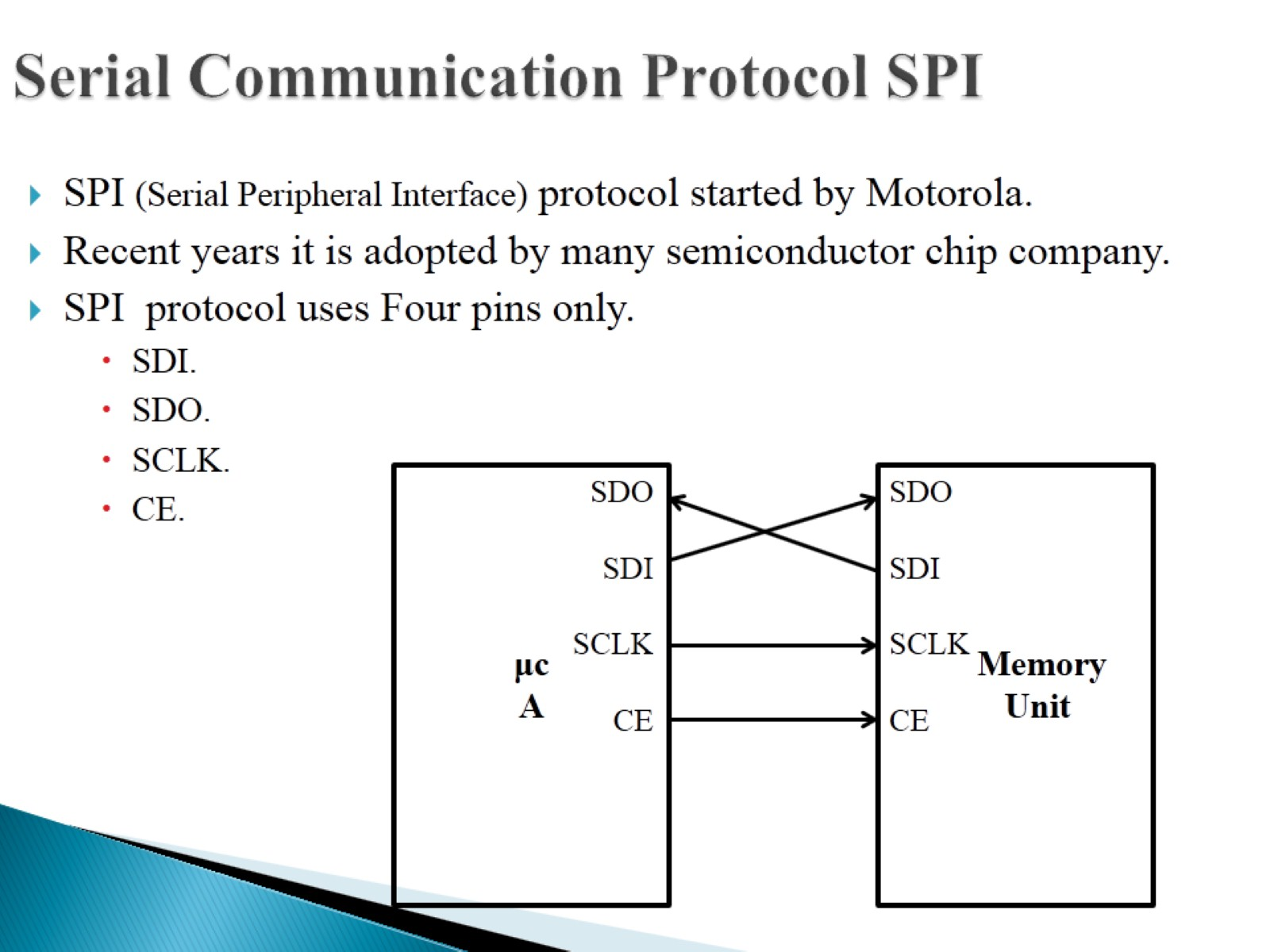
Serial Peripheral Interface

Slide 32
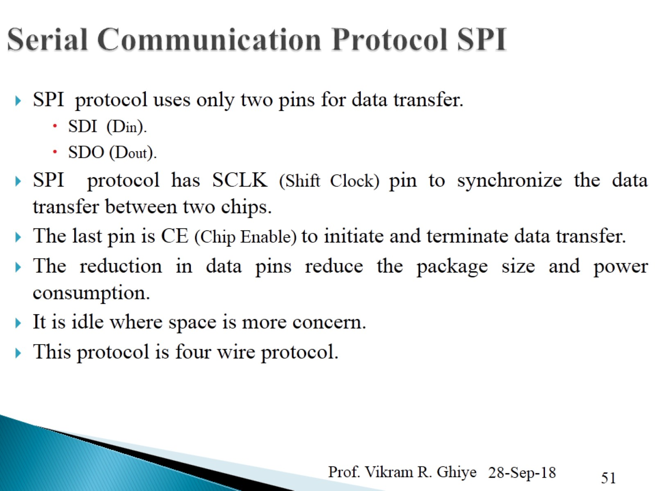

Slide 33
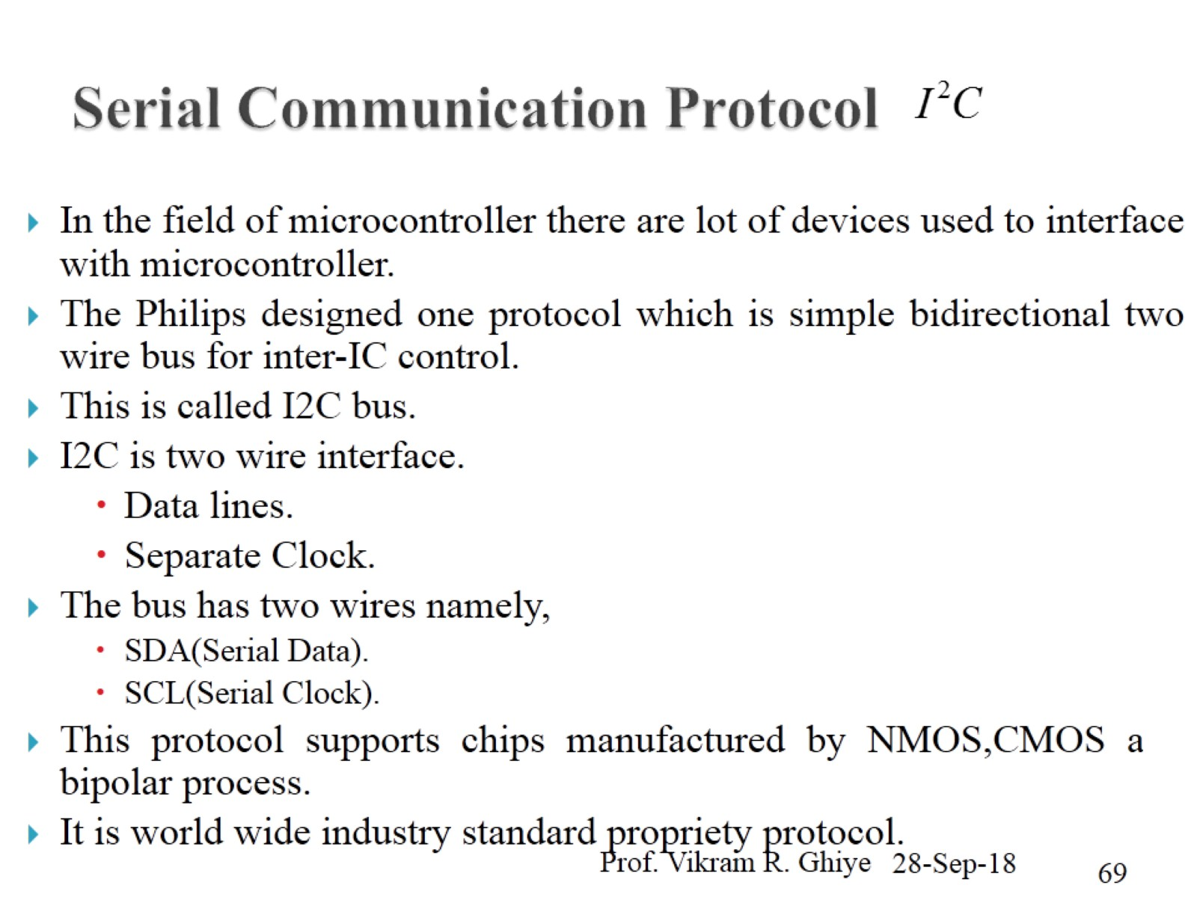
Inter IC Bus Protocol

Slide 34
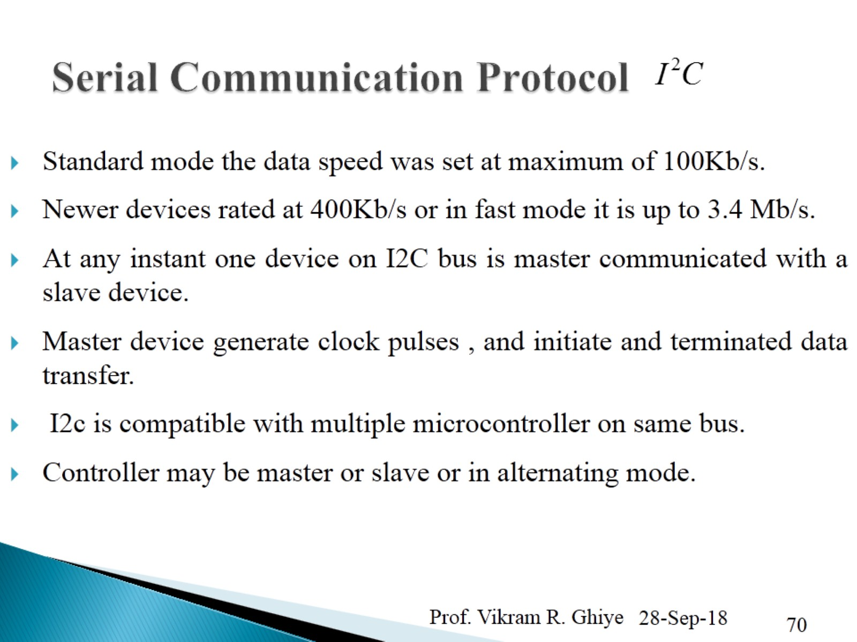

Slide 35
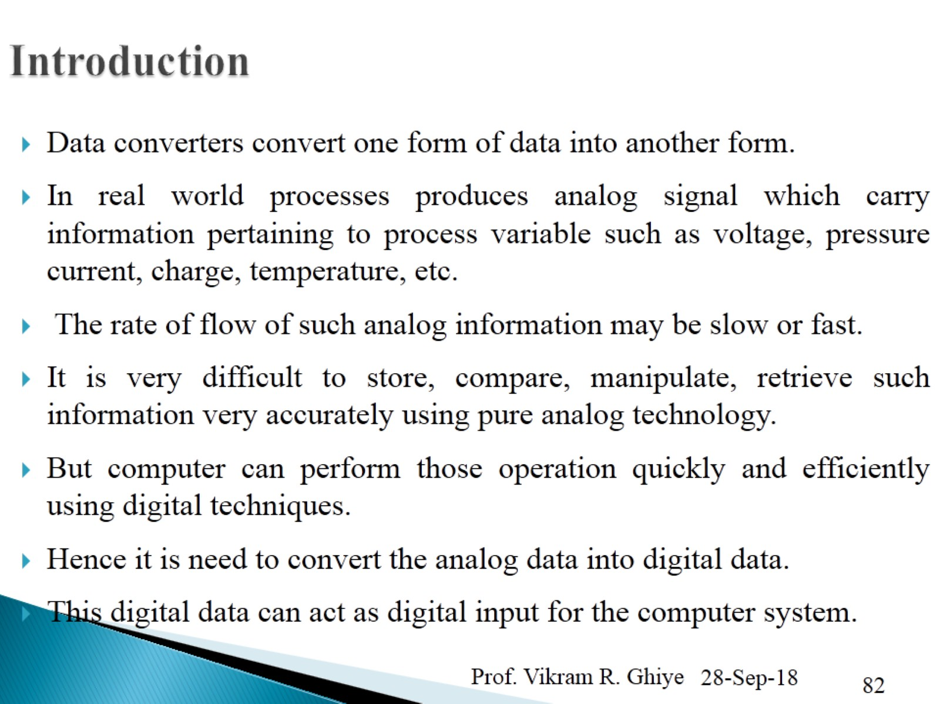
Analog to Digital Converters

Slide 36
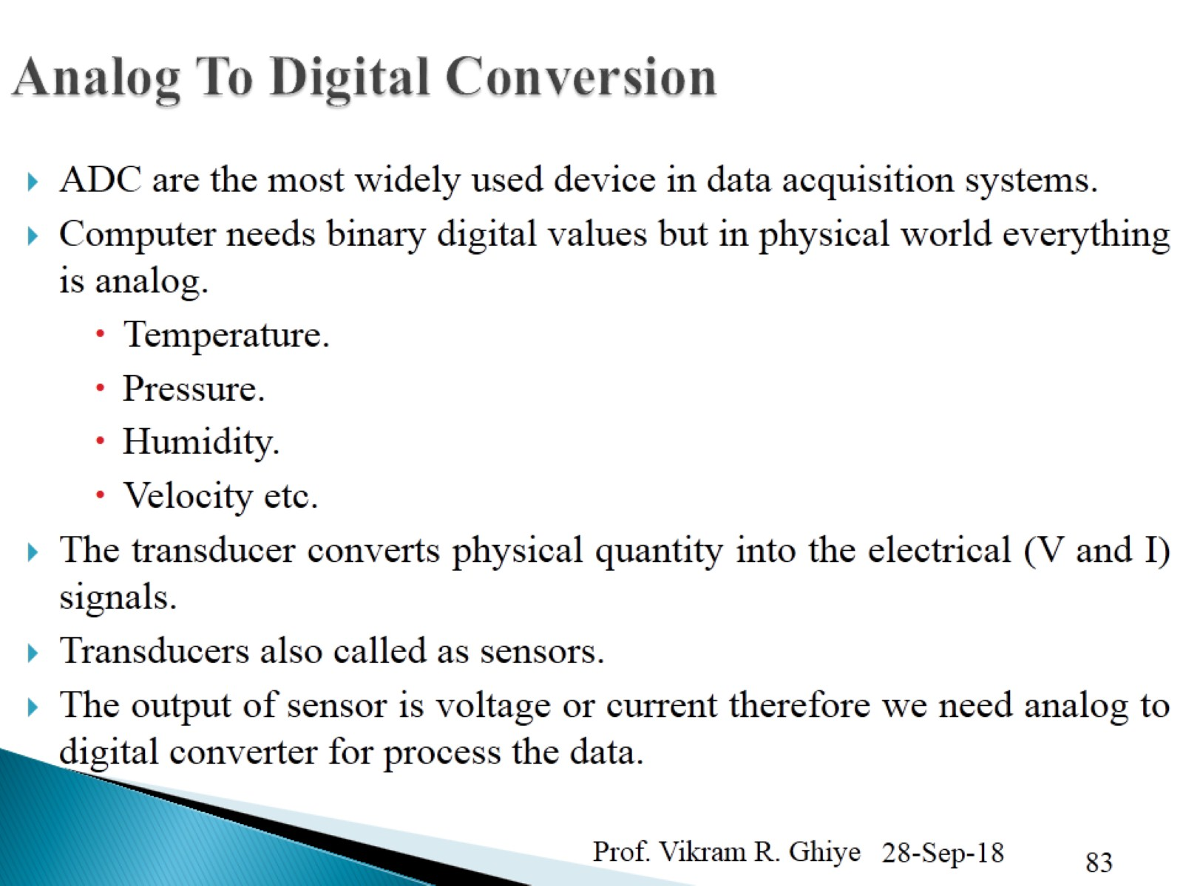

Slide 37
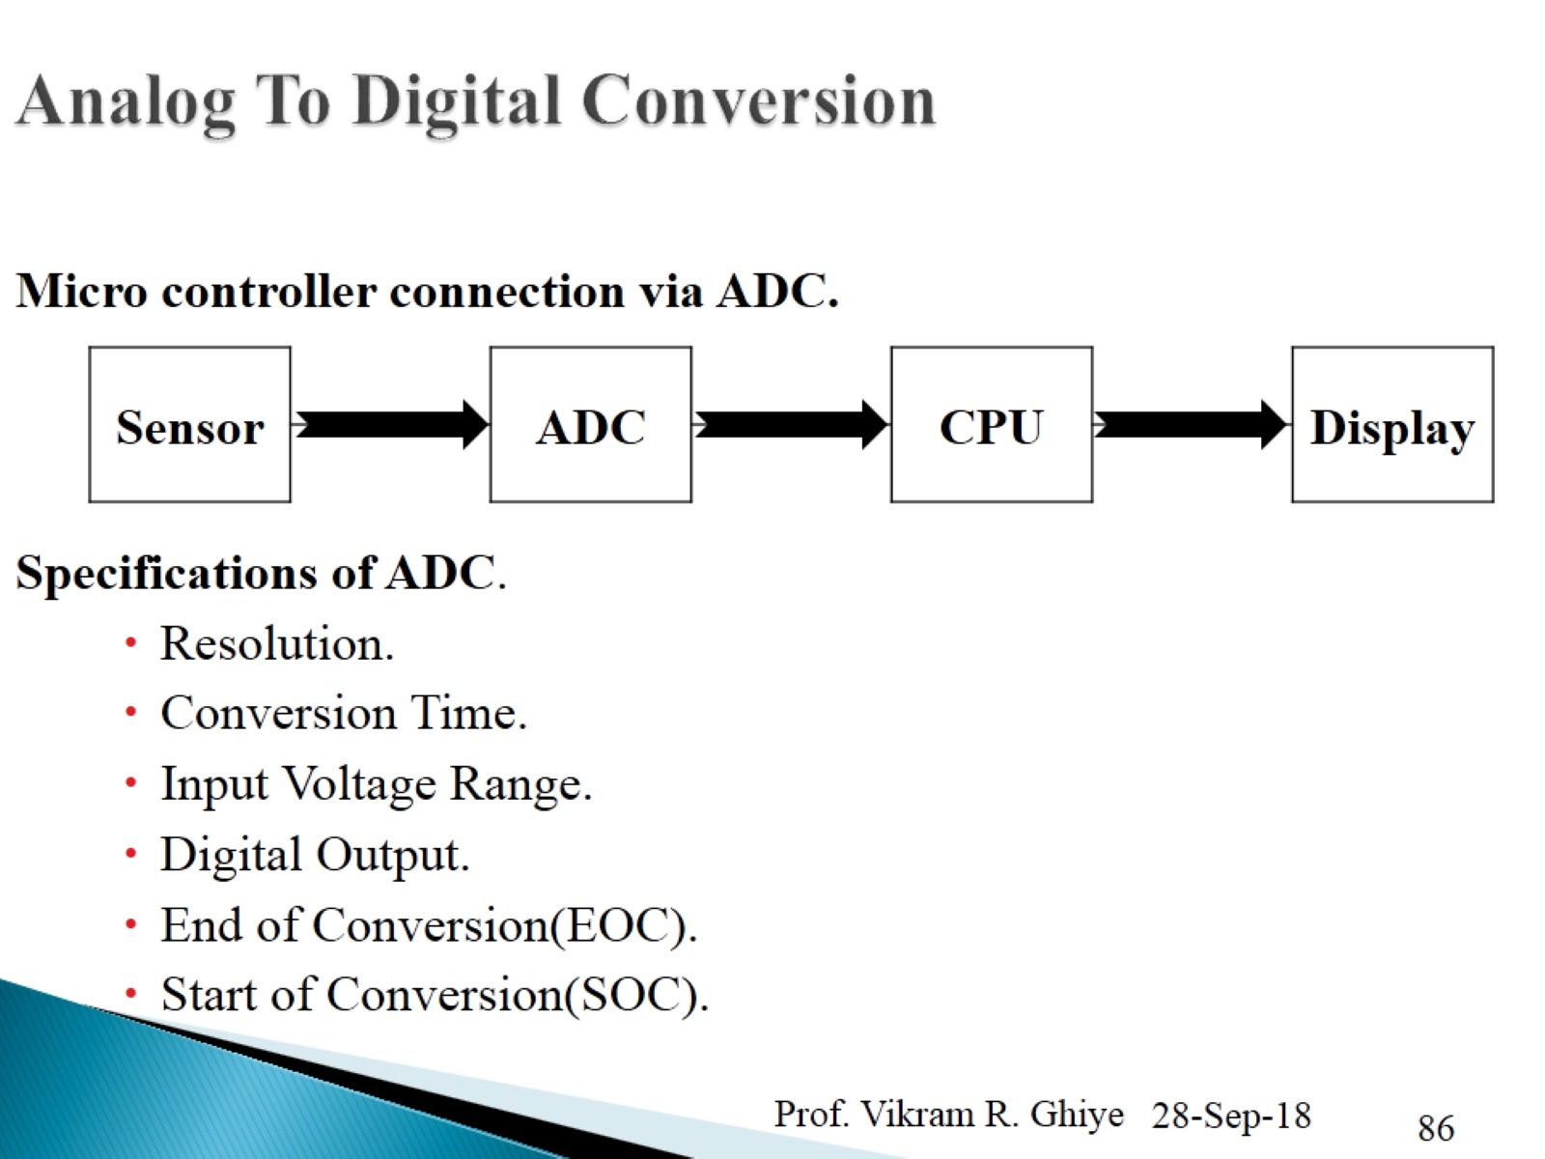

Slide 38
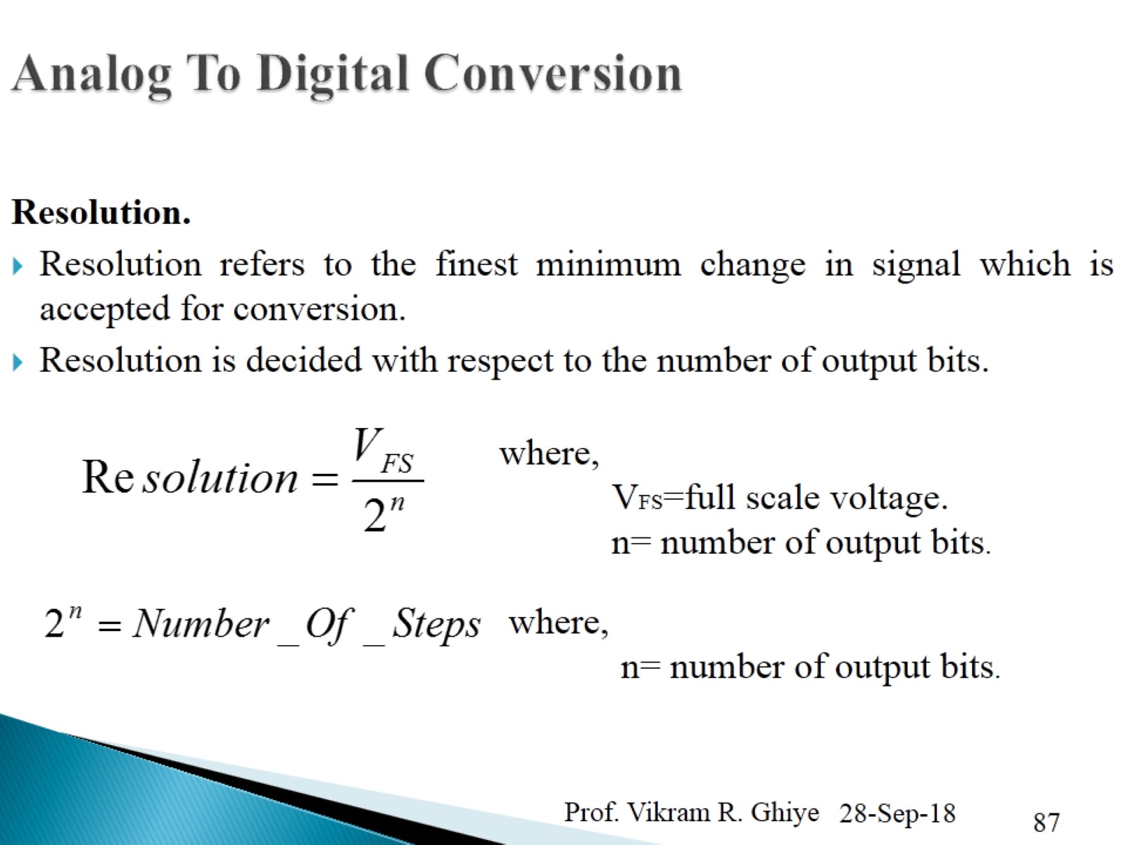
Analog To Digital Conversion

Slide 39
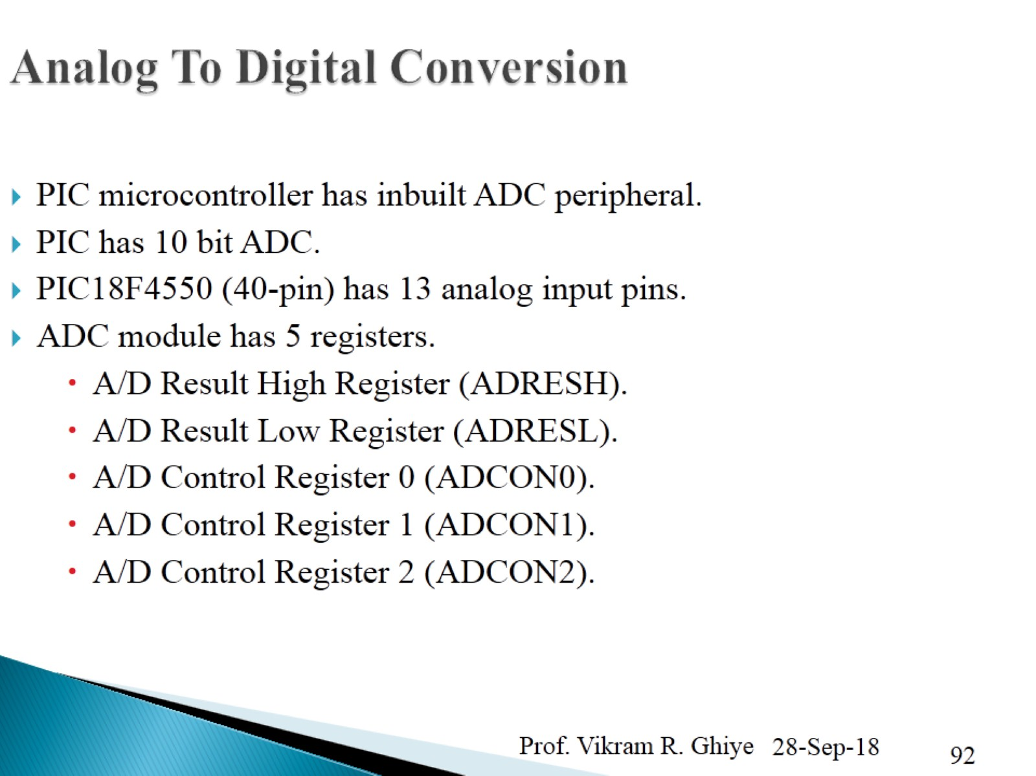

Slide 40
Thank You

